Slide 1
Multivalued Dependencies
Multivalued dependency occurs when two attributes in a table are independent of each other but, both depend on a third attribute.
It means, if in a relation R having A, B and C as attribute. B and C are multivalued facts about A, which is represented as A->->B and A->->C, then multivalued dependency exists only if B and C are independent of each other.
A multivalued dependency consists of at least two attributes that are dependent on a third attribute that's why it always requires at least three attributes.
Slide 11- <number>

Slide 2
Multivalued Dependencies
Definition:
A multivalued dependency (MVD) X —>> Y specified on relation schema R, where X and Y are both subsets of R, specifies the following constraint on any relation state r of R: If two tuples t₁ and t₂ exist in r such that t₁[X] = t₂[X], then two tuples t₃ and t₄ should also exist in r with the following properties, where we use Z to denote (R 2 (X υ Y)):
  t₃[X] = t₄[X] = t₁[X] = t₂[X].
  t₃[Y] = t₁[Y] and t₄[Y] = t₂[Y].
  t₃[Z] = t₂[Z] and t₄[Z] = t₁[Z].
Slide 11- <number>

Slide 3
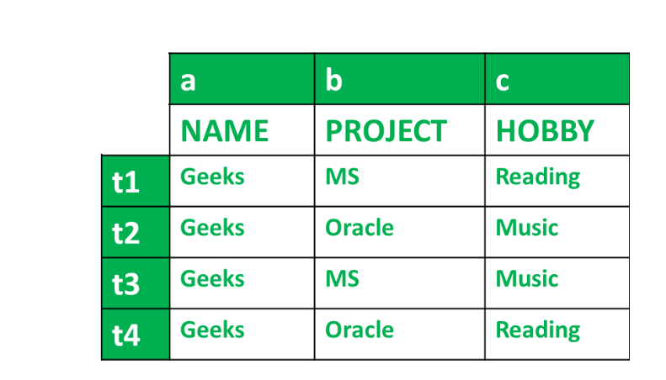
i.e.
Condition-1 for MVD –
t1[a] = t2[a] = t3[a] = t4[a]
t1[a] = t2[a] = t3[a] = t4[a] = Geeks
So, condition 1 is Satisfied.
All conditions are satisfied, therefore,
a --> --> b
According to table we have got,
name --> --> project
And for,
a --> --> C
We get,
name --> --> hobby
Hence, we know that MVD exists in the above table and it can be stated by,
name --> --> project
name --> --> hobby
Condition-2 for MVD –
t1[b] = t3[b] And t2[b] = t4[b]
Finding from table,
t1[b] = t3[b] = MS And t2[b] = t4[b] = Oracle
So, condition 2 is Satisfied.
Condition-3 for MVD –
∃c ∈ R-(a ∪ b) where R is the set of attributes in the relational table.
t1 = t4 And t2=t3
Finding from table,
t1 = t4 = Reading And t2 = t3 = Music
So, condition 3 is Satisfied.
Slide 11- <number>

Slide 4

MVD example
Example: Suppose there is a bike manufacturer company which produces two colors(white and black) of each model every year.
Here columns COLOR and MANUF_YEAR are dependent on BIKE_MODEL and independent of each other.
In this case, these two columns can be called as multivalued dependent on BIKE_MODEL. The representation of these dependencies is shown below:
  BIKE_MODEL → → MANUF_YEAR
  BIKE_MODEL → → COLOR
This can be read as "BIKE_MODEL multidetermined MANUF_YEAR" and "BIKE_MODEL multidetermined COLOR".
Slide 11- <number>

Slide 5
4NF
Definition:
A relation schema R is in 4NF with respect to a set of dependencies F (that includes functional dependencies and multivalued dependencies) if, for every nontrivial multivalued dependency X —>> Y in F⁺, X is a superkey for R.
  Note: F⁺ is the (complete) set of all dependencies (functional or multivalued) that will hold in every relation state r of R that satisfies F. It is also called the closure of F.
  OR
A relation R is in 4NF if and only if,
  It is in BCNF
  It has no Multivalued Dependencies
Slide 11- <number>
Notes:
Fourth normal form (4NF) is a normal form used in database normalization, in which there are no non-trivial multivalued dependencies except a candidate key. After Boyce–Codd normal form (BCNF), 4NF is the next level of normalization. Although the second, third, and Boyce–Codd normal forms operate with functional dependencies, 4NF is operated with a more universal type of dependency known as a multivalued dependency.
A relation R with attributes, its values and tuples is in 4NF if and only if the following conditions are satisfied.
The relation or table should be in the Boyce-Codd Normal Form (BCNF).
The relation or table should not have any Multivalued Dependency.
A table which consists of a multivalued dependency breaches the normalization attainment of Fourth Normal Form (4NF) because it generates unneeded redundancies and can contribute to incompatible data which will not be inconsistency. To take this forward and up towards 4NF, it is important to divide this data and information into two tables or relations.

Slide 6
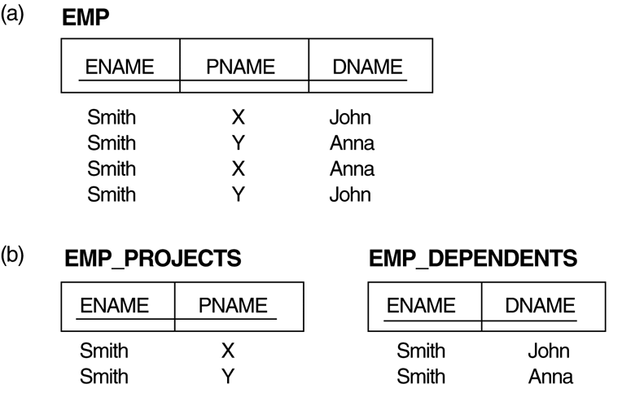
3. Multivalued Dependencies and Fourth Normal Form (1)
The EMP relation with two MVDs: ENAME —>> PNAME and ENAME —>> DNAME.
Decomposing the EMP relation into two 4NF relations EMP_PROJECTS and EMP_DEPENDENTS.
Slide 11- <number>

Slide 7
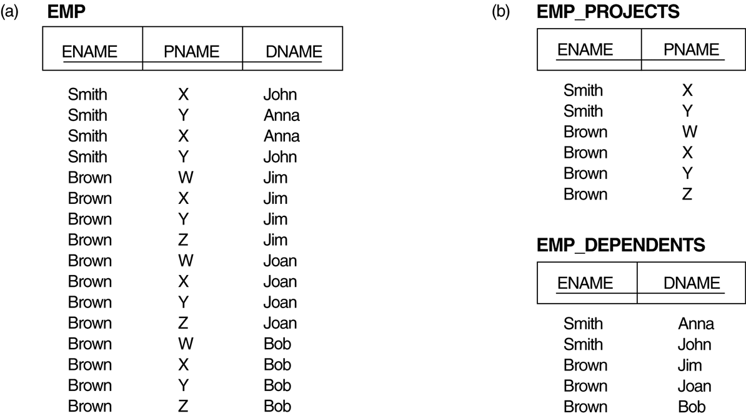
Multivalued Dependencies and Fourth Normal Form (5)
Decomposing a relation state of EMP that is not in 4NF:
EMP relation with additional tuples.
Two corresponding 4NF relations EMP_PROJECTS and EMP_DEPENDENTS.
Slide 11- <number>

Slide 8



3. Multivalued Dependencies and Fourth Normal Form (1)
Ex2
STU_ID —>> COURSE, STU_ID —>> HOBBY
Slide 11- <number>

Slide 9
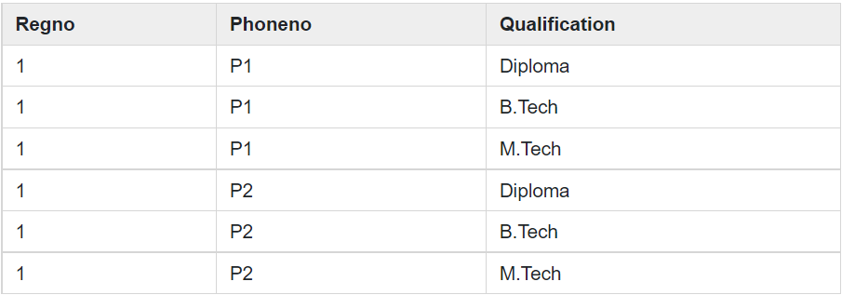

3. Multivalued Dependencies and Fourth Normal Form (1)
Ex3
Regno—>> Phoneno, Regno—>> Qualification
Slide 11- <number>

Slide 10
Multivalued Dependencies and Fourth Normal Form (3)
Inference Rules for Functional and
Multivalued Dependencies:
  IR1 (reflexive rule for FDs): If X ⊇ Y, then X –> Y.
  IR2 (augmentation rule for FDs): {X –> Y} ⏐= XZ –> YZ.
  IR3 (transitive rule for FDs): {X –> Y, Y –>Z} ⏐= X –> Z.
  IR4 (complementation rule for MVDs): {X —>> Y} ⏐= X —>>
  (R – (X ∪ Y))}.
  IR5 (augmentation rule for MVDs): If X —>> Y and W ⊇ Z
  then WX —>> YZ.
  IR6 (transitive rule for MVDs): {X —>> Y, Y —>> Z} ⏐= X —>> (Z 2 Y).
  IR7 (replication rule for FD to MVD): {X –> Y} ⏐= X —>> Y.
  IR8 (coalescence rule for FDs and MVDs): If X —>> Y and there exists W with the properties that
    (a) W ∩ Y is empty, (b) W –> Z, and (c) Y ⊇ Z, then X –> Z.
Slide 11- <number>

Slide 11
Multivalued Dependencies and Fourth Normal Form (6)
Lossless (Non-additive) Join Decomposition into 4NF Relations:
PROPERTY LJ1’
  The relation schemas R₁ and R₂ form a lossless (non-additive) join decomposition of R with respect to a set F of functional and multivalued dependencies if and only if
    (R₁ ∩ R₂) —>> (R₁ - R₂)
  or by symmetry, if and only if
    (R₁ ∩ R₂) —>> (R₂ - R₁)).
Slide 11- <number>

Slide 12
Join Dependency
Join decomposition is a further generalization of Multivalued dependencies.
If the join of R1 and R2 over C is equal to relation R, then we can say that a join dependency (JD) exists.
Where R1 and R2 are the decompositions R1(A, B, C) and R2(C, D) of a given relations R (A, B, C, D).
Alternatively, R1 and R2 are a lossless decomposition of R.
A JD ⋈ {R1, R2,..., Rn} is said to hold over a relation R if R1, R2,....., Rn is a lossless-join decomposition.
The *(A, B, C, D), (C, D) will be a JD of R if the join of join's attribute is equal to the relation R.
Here, *(R1, R2, R3) is used to indicate that relation R1, R2, R3 and so on are a JD of R.
Slide 11- <number>
Notes:
JD is a generalization of Multivalued Dependency.

Slide 13
4. Join Dependencies and Fifth Normal Form (1)
Definition:
A join dependency (JD), denoted by JD(R₁, R₂, ..., R_{n}), specified on relation schema R, specifies a constraint on the states r of R.
  The constraint states that every legal state r of R should have a non-additive join decomposition into R₁, R₂, ..., R_{n}; that is, for every such r we have
  * (π_{R1}(r), π_{R2}(r), ..., π_{Rn}(r)) = r
Note: an MVD is a special case of a JD where n = 2.
A join dependency JD(R₁, R₂, ..., R_{n}), specified on relation schema R, is a trivial JD if one of the relation schemas R_{i} in JD(R₁, R₂, ..., R_{n}) is equal to R.
5NF is also known as Project-join normal form (PJ/NF).
Slide 11- <number>

Slide 14
Join Dependencies and Fifth Normal Form (2)
Definition:
A relation R is in 5NF if and only if every join dependency in R is implied by the candidate keys of R. A relation decomposed into two relations must have loss-less join Property, which ensures that no spurious or extra tuples are generated, when relations are reunited through a natural join.
OR
A relation schema R is in fifth normal form (5NF) (or Project-Join Normal Form (PJNF)) with respect to a set F of functional, multivalued, and join dependencies if,
  for every nontrivial join dependency JD(R₁, R₂, ..., R_{n}) in F⁺ (that is, implied by F),
    every R_{i} is a superkey of R.
Slide 11- <number>
Notes:
Fifth normal form (5NF), also known as projection–join normal form (PJ/NF), is a level of database normalization designed to remove redundancy in relational databases recording multi-valued facts by isolating semantically related multiple relationships. A table is said to be in the 5NF if and only if every non-trivial join dependency in that table is implied by the candidate keys. It is the final normal form as far as removing redundancy is concerned.
A relation is in 5NF if it is in 4NF and not contains any join dependency and joining should be lossless.
5NF is satisfied when all the tables are broken into as many tables as possible in order to avoid redundancy.
5NF is also known as Project-join normal form (PJ/NF).

Slide 15
Join Dependencies and Fifth Normal Form (2)
Properties – A relation R is in 5NF if and only if it satisfies following conditions:
  R should be already in 4NF.
  It cannot be further non loss decomposed (join dependency)
Slide 11- <number>

Slide 16
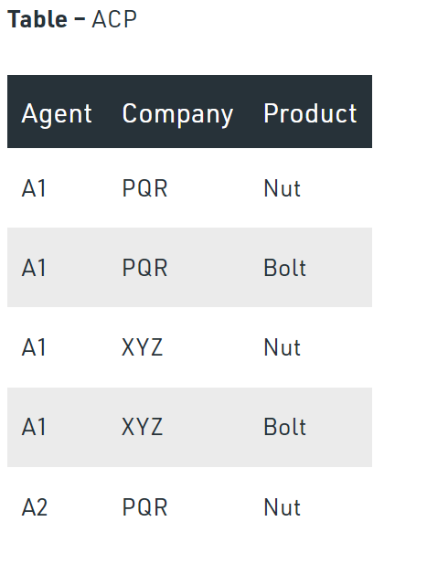
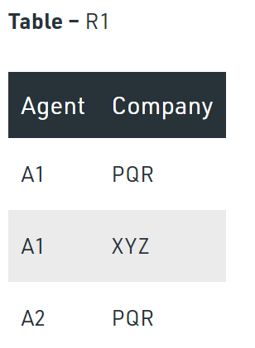
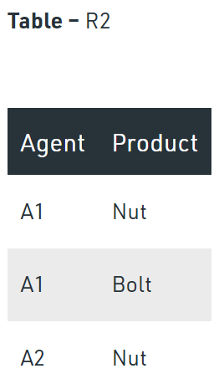
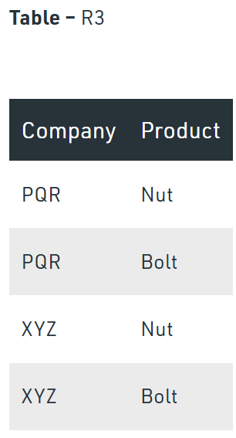
The relation ACP is again decompose into 3 relations. Now, the natural Join of all the three relations will be shown as:
Result of Natural Join of R1 and R3 over ‘Company’ and then Natural Join of R13 and R2 over ‘Agent’and ‘Product’ will be table ACP.
Hence, in this example, all the redundancies are eliminated, and the decomposition of ACP is a lossless join decomposition. Therefore, the relation is in 5NF as it does not violate the property of lossless join.
Slide 11- <number>

Slide 17
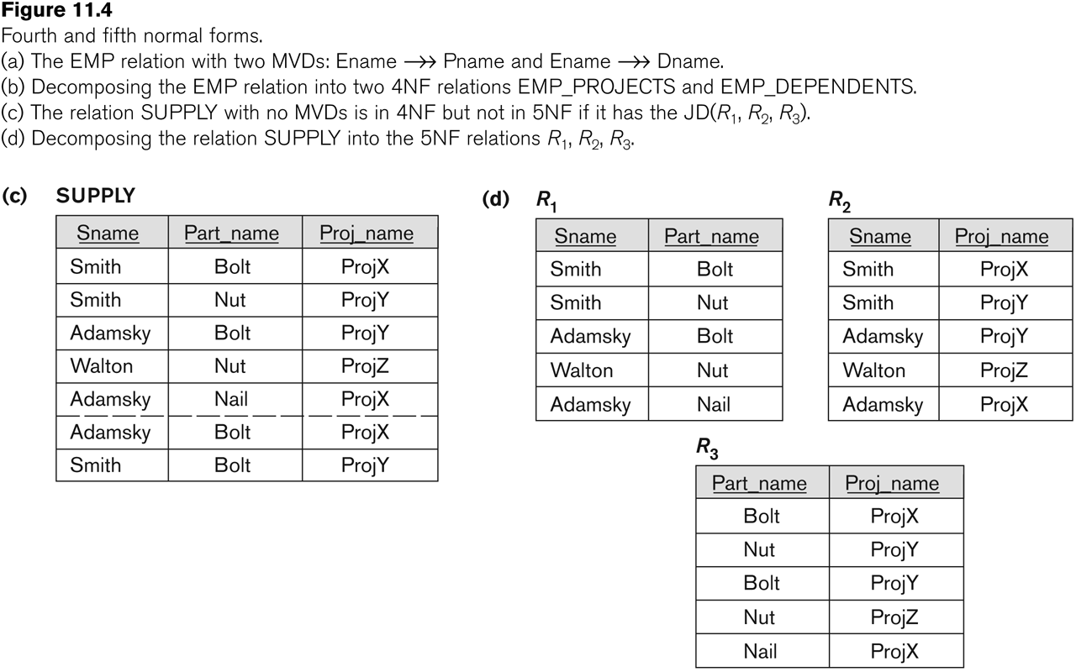
Relation SUPPLY with Join Dependency and conversion to Fifth Normal Form
Slide 11- <number>

Slide 18
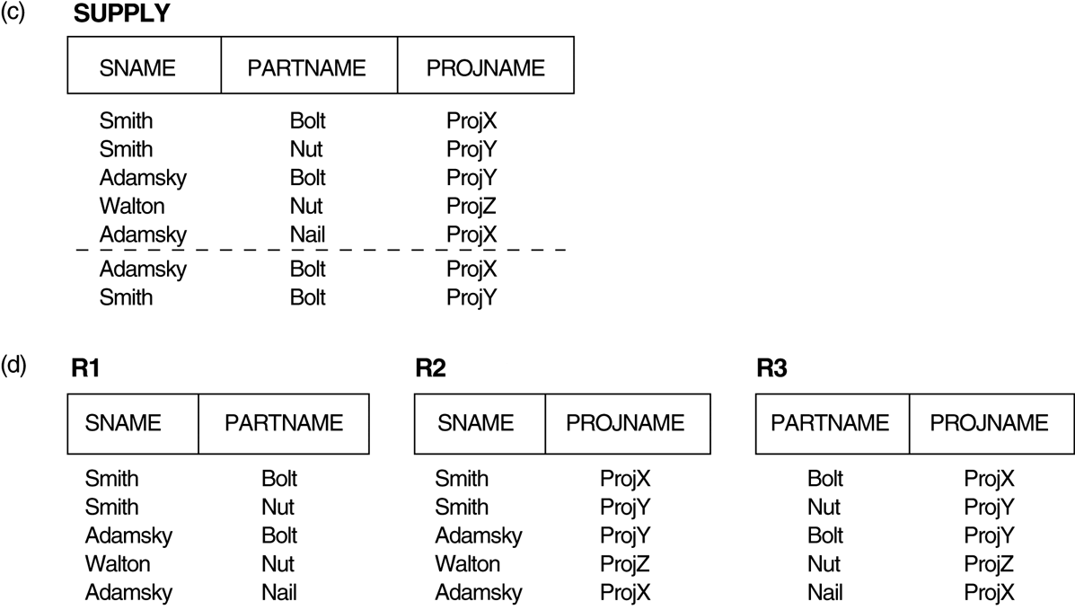
3. Multivalued Dependencies and Fourth Normal Form (1)
(c) The relation SUPPLY with no MVDs is in 4NF but not in 5NF if it has the JD(R1, R2, R3). (d) Decomposing the relation SUPPLY into the 5NF relations R1, R2, and R3.
Slide 11- <number>

